Slide 1

RESEARCH SUMMER 2021 WEEKLY REVIEW
Nile Coble Weekly Review

Slide 2
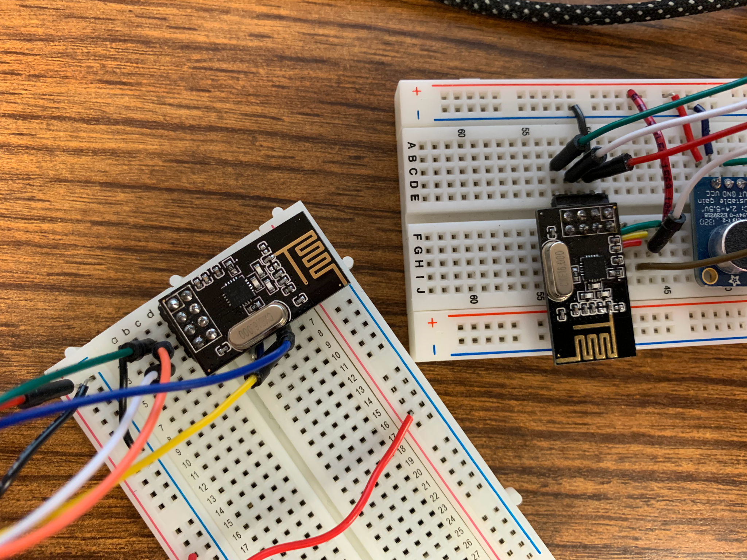
Slow progress with nRF radios

Slide 3
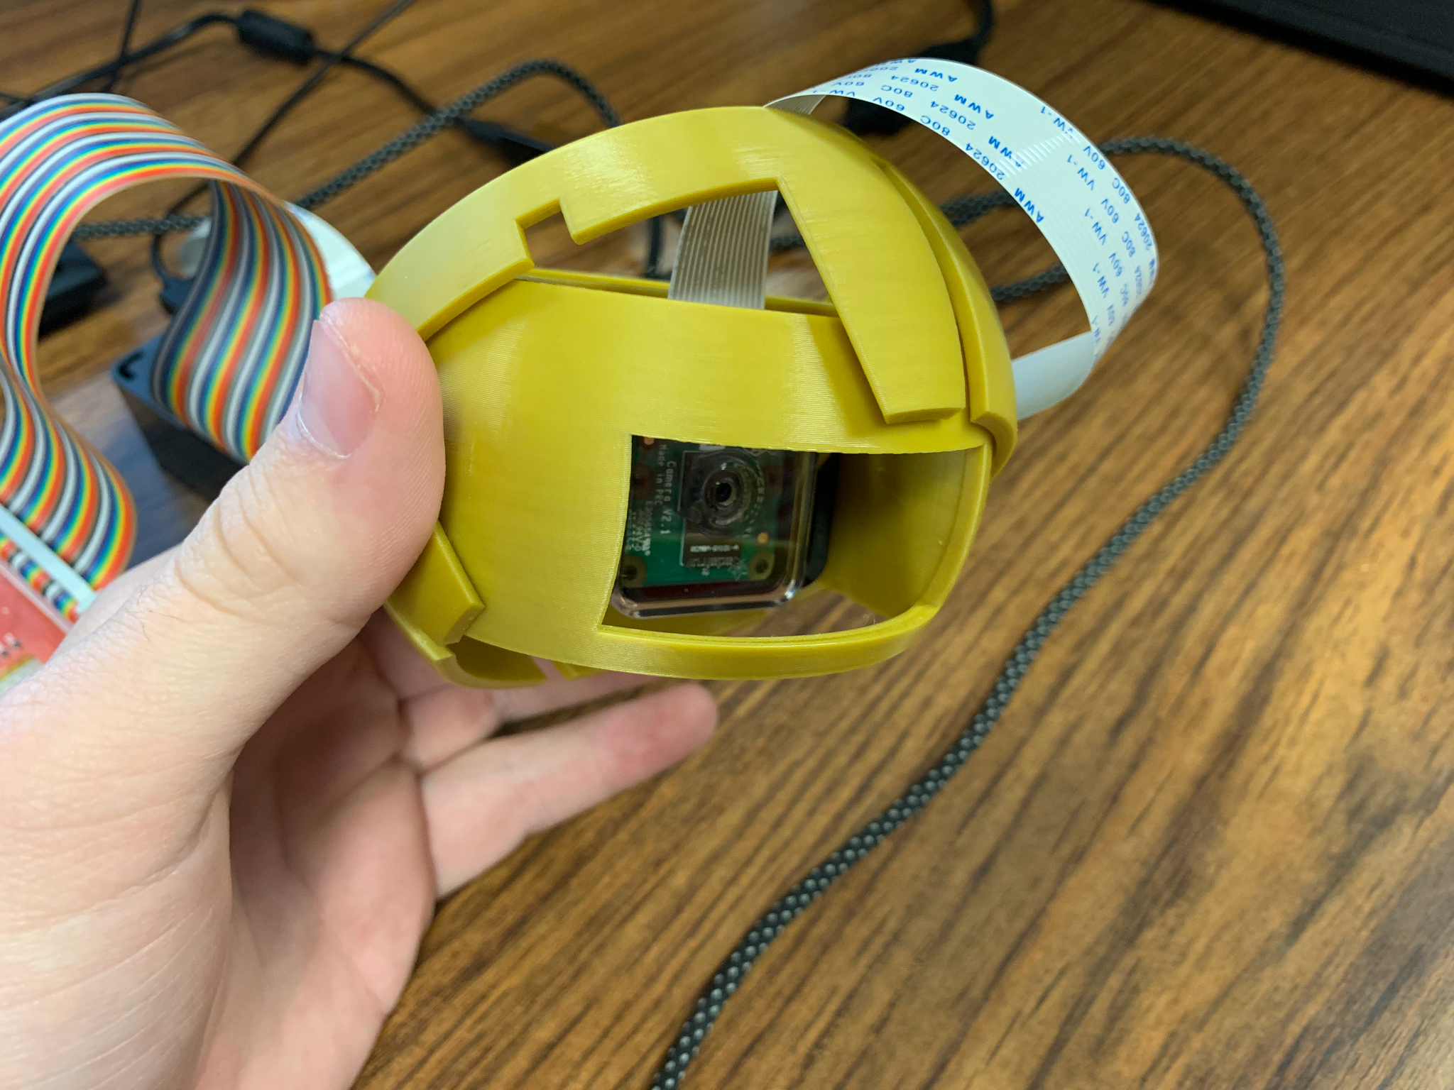
I made a cool camera mount
Next Up:
Power Pi with batteries
Design housing

Slide 4
THANK YOU

